Slide 2
Inductance of a solenoid
Basic Equations:
A

Slide 3
Magnetic field inside a solenoid
Basic Equation: Ampere’s Law
2
1
3
4

Slide 5
Inductor Symbol

Slide 6
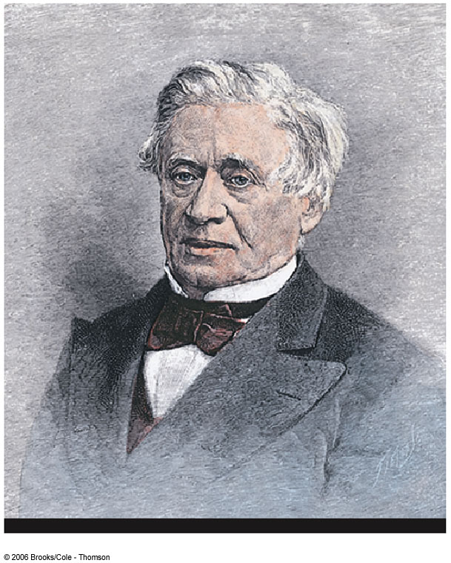
Joseph Henry
1797 – 1878
First director of the Smithsonian
First president of the Academy of Natural Science
First to produce an electric current with a magnetic field
Improved the design of the electro-magnetic and constructed a motor
Discovered self-inductance

Slide 8
Spring Mass System
Basic Equations:
V_{max}
m
x=0
x_{max}
Differential Equation
k
V=0
V=0
m
m
x=0
x_{max}
-x_{max}
x=0
V_{max}
Solution
m
x=0
x_{max}
Is the amplitude of the oscillation
Is the angular frequency
Is the phase (time offset)

Slide 9
LC Circuit, Charge, Current
Basic Equations:
L
C
Assumptions:
No Resistance
No Radiation
Solution function:
Differential Equation
Use Initial Conditions

Slide 10
LC Circuit, Charge, Current
90° out of phase
Q
When Q =Q_{max}, I=0
When I=I_{max}, Q=0
I
T/2
T

Slide 11
LC Circuit, Energy
Basic Equations:
L
C
Assumptions:
No Resistance
No Radiation
1
Reasonable?

Slide 12
U_{B}
U_{E}
L
C
U_{B}
U_{E}
U_{B}
U_{E}
L
C
L
C
L
C
L
C
U_{B}
U_{E}
U_{B}
U_{E}
L
C
L
C
L
C
U_{B}
U_{E}
U_{B}
U_{E}
U_{B}
U_{E}
After Halliday and Resnick Figure 35-1

Slide 14
RLC Circuit, Analysis
The total energy is not constant, since there is a transformation to internal energy in the resistor at the rate of dU/dt = -I ²R
Radiation losses are still ignored
The circuit’s operation can be expressed as

Slide 15
RLC Circuit Compared to Damped Oscillators
The RLC circuit is analogous to a damped harmonic oscillator
When R = 0
The circuit reduces to an LC circuit and is equivalent to no damping in a mechanical oscillator

Slide 16
RLC Circuit Compared to Damped Oscillators, cont.
When R is small:
The RLC circuit is analogous to light damping in a mechanical oscillator
Q = Q_{max} e^{-Rt/2L} cos ω_{d}t
ω_{d} is the angular frequency of oscillation for the circuit and

Slide 17
RLC Circuit Compared to Damped Oscillators, final
When R is very large, the oscillations damp out very rapidly
There is a critical value of R above which no oscillations occur
If R = R_{C}, the circuit is said to be critically damped
When R > R_{C}, the circuit is said to be overdamped

Slide 18
S₁
R
L
E
C
S₂

Slide 19
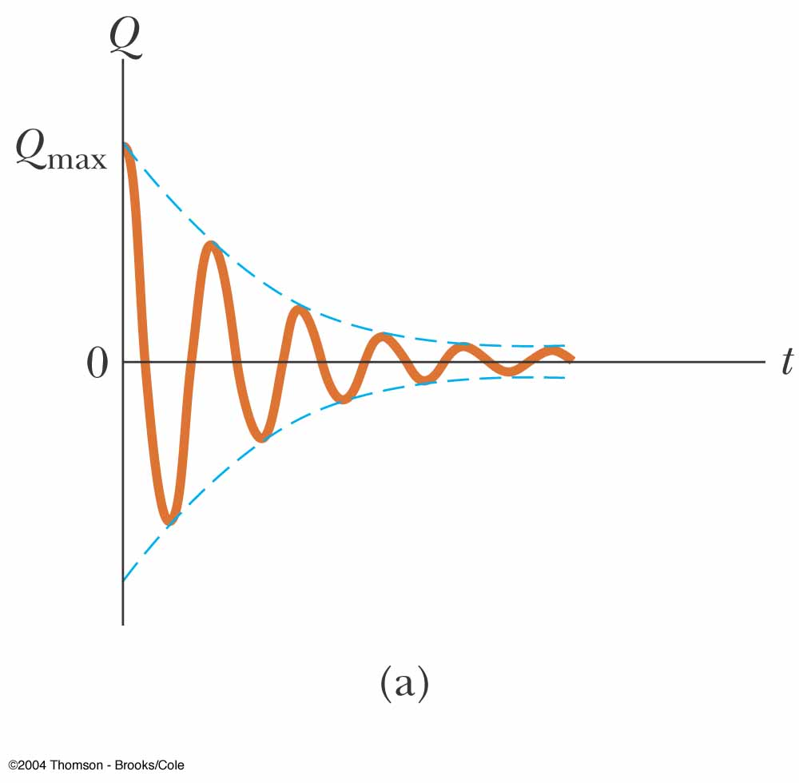
Damped RLC Circuit, Graph
The maximum value of Q decreases after each oscillation
R < R_{C}
This is analogous to the amplitude of a damped spring-mass system

Slide 21
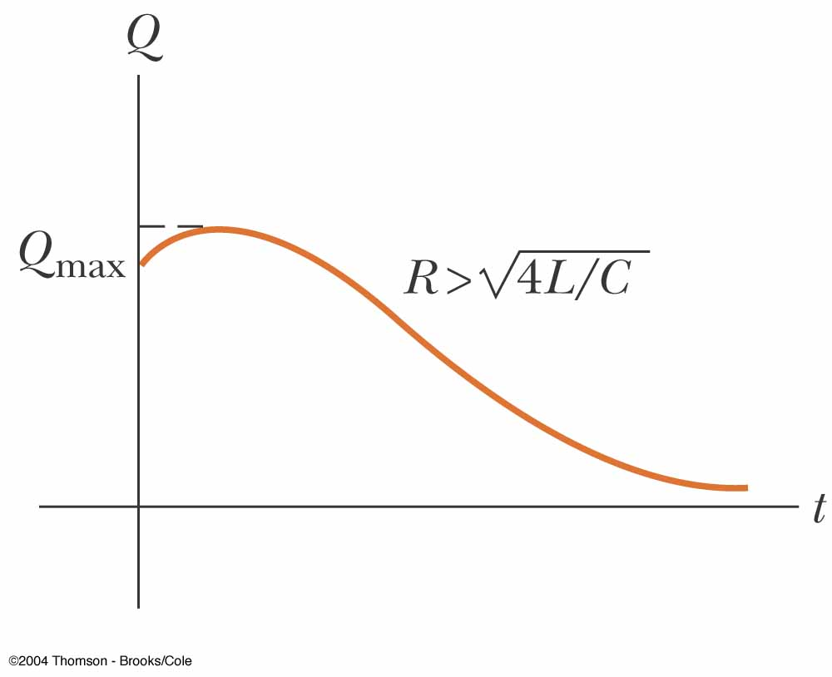
Overdamped RLC Circuit, Graph
The oscillations damp out very rapidly
Values of R are greater than R_{C}

Slide 22
Strange Circuit 1
A
x x
x x x x
x x
V₁
R₁
R₂
V₂
D
Changing Magnetic Flux

Slide 23
Strange Circuit 1
A
I₁
I
I₂
x x
x x x x
x x
V₁
R₁
R₂
V₂
D
Changing Magnetic Flux

Slide 24
Strange Circuit 2
R
E
I

Slide 25
Strange Circuit 2
ds
R
E
B
I

Slide 26
Strange Circuit 2
ds
R
V
E
B
I

Slide 27
Strange Circuit 2
ds
R
V
E
B
I
New Loop Area

Slide 28
Inductor in a Circuit
Inductance can be interpreted as a measure of opposition to the rate of change in the current
Remember resistance R is a measure of opposition to the current
As a circuit is completed, the current begins to increase, but the inductor produces an emf that opposes the increasing current
Therefore, the current doesn’t change from 0 to its maximum instantaneously

Slide 29
RL Circuit
When the current reaches its maximum, the rate of change and the back emf are zero
The time constant, τ, for an RL circuit is the time required for the current in the circuit to reach 63.2% of its final value

Slide 30
RL Circuit, cont
The time constant depends on R and L
The current at any time can be found by

Slide 31
Energy Stored in a Magnetic Field
The emf induced by an inductor prevents a battery from establishing an instantaneous current in a circuit
The battery has to do work to produce a current
This work can be thought of as energy stored by the inductor in its magnetic field
PE_{L} = ½ L I²

Slide 32
Finding the Current in and RL Circuit
R
Basic Equations:
E
L
Find
Change variables
Where

Slide 33
Finding the Current in an RL Circuit
R
Basic Equations:
L
then
Choose a function for I

Slide 34
L
C

Slide 35
Energy in the B-field (RL Circuit)
Basic Equations:
R
E
L
Example:
Identify
Solve for energy in the Inductor
Compare

Slide 36
Energy in the B-field (Solenoid)
Basic Equations:
R
E
L
Multiply by 1
Rearrange Terms
Result is true in general!
Compare
Volume of Solenoid

Slide 37
R
E
L

Slide 38
N₁
N₂
Φ₁₂
Coil 1
Coil 2

Slide 39
Mutual Induction
N₁
N₂
Basic Equations:
Φ₁₂
Coil 1
Coil 2
Note:

Slide 40
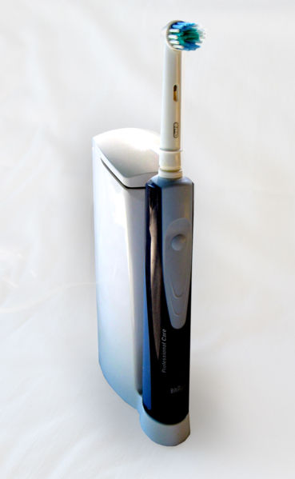

Slide 41
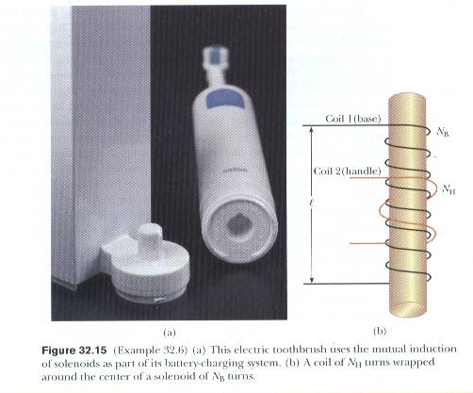
Serway and Jewett

Slide 42
I
l
a
b

Slide 43
